Slide 1
MEALSON · PRODUCT CASE STUDY
Elevating Scheduled Meals
Why meal subscriptions keep failing — and the three changes that would make this one work
Jitendra Singh · Product Manager
Notes:
Open with the reframe, not a feature list. The question I asked myself was not "what should we add to Scheduled Meals" but "why does this category keep failing, and what would make it structurally work."

Slide 2
BEFORE WE START
Assumptions I am working from
Business context
MealsOn is an established on-demand food delivery platform. Scheduled Meals exists today but is under-performing against its growth potential — that is why it has been flagged as a key growth area.
Market
India-first, metro cities. Users have realistic alternatives: local tiffin services, cooking at home, and on-demand delivery.
Supply model
A mix of cloud kitchens, home chefs, and tiffin vendors — so kitchen capacity is real, finite, and needs a demand forecast to plan against.
Data access
I do not have MealsOn’s funnel data. Where I quote numbers they are stated as hypotheses to validate, never as facts.
Scope
I have prioritised for the next 2–3 quarters, not an unbounded wish list.
Notes:
State assumptions explicitly — the brief asks for this. Flag that I have no access to their funnel data, so every number I use is a hypothesis to validate, not a claim.

Slide 3
THE REFRAME
This category has a graveyard
Meal subscriptions are not an untried idea. They have been launched, shelved, and relaunched by the largest players in the market.
So the useful question is not
“What features should we
add to Scheduled Meals?”
2019
Swiggy launches Daily — a standalone home-style meal subscription app
2020
Shelved. Demand dwindles through the Covid period
It is
“Why does this keep failing — and what would make it structurally work?”
2023
Zomato enters the affordable home-style meal segment with Everyday
2024
Swiggy relaunches Daily in Bengaluru — this time inside the main app, not standalone
Sources: public reporting on Swiggy Daily (2019 launch, 2024 Bengaluru relaunch) and Zomato Everyday.
Notes:
This is the slide that separates the submission. Everyone else opens with a feature list. Anchor on the fact that the biggest players in the market have already failed at this once.

Slide 4
DIAGNOSIS
Four reasons meal subscriptions break
1
2
3
4
Commitment barrier
Menu fatigue
Life is not a calendar
Flexibility is expensive
Paying for 30 days of food from a kitchen you have never tried is a large, unhedged bet. Most users never start.
The single biggest churn driver in every subscription food business. By week three the user is bored of the rotation.
I am travelling Tuesday. At my parents’ Friday. Ate late today. Rigid schedules break against real life — and every broken meal is a payment the user feels they wasted.
Kitchens need a demand forecast to prep against. Every skip, swap and reschedule degrades that forecast and raises cost to serve.
BLOCKS ACTIVATION
BLOCKS RENEWAL
BLOCKS RENEWAL
THE CORE TENSION
Note the fourth one — it is not a user problem, it is an operating constraint. Any solution that ignores it will look good in a demo and lose money in production.
Notes:
Emphasise failure mode 4 in the video. Most candidates will only talk about user-side problems. The flexibility/forecast tension is the real product constraint and naming it shows operating depth.

Slide 5
WHY THIS DESERVES INVESTMENT
Scheduled Meals is a margin play, not just a retention feature
1
2
3
Demand becomes
predictable
Delivery routes
get dense
You acquire the
order once
Kitchens can batch-prep against a known forecast instead of reacting to spikes. Higher utilisation, less waste.
Known drop points at known times cluster naturally. More drops per rider hour.
On-demand re-competes for every single order. A subscription converts once and delivers many times.
The strategic argument
Every order shifted from on-demand to scheduled should carry structurally better contribution margin. That reframes the investment case: this is not “a nice feature for busy people”, it is a lever on unit economics — which is what earns roadmap space against competing bets.
Hypothesis to validate against MealsOn’s actual cost-to-serve data before committing spend.
Notes:
Zoom out to the business. This is what justifies investment to a commercial stakeholder — not user delight alone.

Slide 6
WHO THIS IS FOR
Four users, one shared job
1
The time-poor professional
“Stop making me choose every day.”
Long hours, no energy to decide. Wants lunch solved without thinking.
2
The migrant / student
“I want food that tastes like home, at a price I can hold.”
Away from home, no kitchen, price-sensitive. Wants home-style food consistently.
3
The health-goal user
“Keep me on my plan without the effort.”
Tracking calories or protein. Currently served by macro-tracked meal players.
4
The remote carer
“I cannot cook for them, but I can make sure they eat.”
Buying for someone else — elderly parents, new parents in another city.
The shared job: remove the daily decision, without removing control.
Notes:
The remote carer is the least obvious and most underserved — it expands the buyer beyond the eater, which is a different growth vector than the other three.

Slide 7
WHERE THE VALUE LEAKS
Two leaks matter. The rest is noise.
Discover
›
Consider
›
Commit
›
Consume
›
Renew
Leak 1 · Consider → Commit
The user is interested but will not place a large, irreversible bet on an unfamiliar kitchen. They browse and leave.
Caused by failure mode 1
Leak 2 · Consume → Renew
The user started, then hit menu fatigue or found the schedule did not fit their week. They finish the cycle and do not come back.
Caused by failure modes 2 and 3
Sequencing principle: fix the leaky bucket before pouring more in. Driving acquisition into a product that churns wastes the spend.
Notes:
This slide sets up the roadmap sequencing. Retention before acquisition — and I can defend why.

Slide 8
COMPETITIVE READ
Table stakes already exist. Differentiation has to go further.
Already solved in market
Where I would not compete
Pause, skip, change and cancel a meal
3-day, 7-day and month-long plan lengths
Daily-changing home-style menus, veg and non-veg
Vendor hygiene and quality checklists
Calorie and macro-tracked meals (health players)
Price and “home-style” positioning. That is a margin war against two players with deeper pockets and a restaurant-delivery duopoly behind them. Winning there costs more than it returns.
A different axis
Compete on flexibility economics and personalisation — not on being 10 rupees cheaper.
The gap nobody has closed
Every player still sells a calendar. Buy Monday to Friday, then fight the product when your week changes. Nobody has decoupled “I bought meals” from “I must eat them on these specific days.”
Based on publicly reported feature sets. Would validate against live competitor apps before finalising.
Notes:
Be honest that table-stakes flexibility already exists — claiming skip/pause as an innovation would be wrong and easy to catch.

Slide 9
THE CORE IDEA
Sell meals, not days
Replace the fixed calendar subscription with a meal credit wallet. Buy 20 meals, use them across 60 days, on whatever days the user actually wants them.
The trade-off I am accepting
Credits weaken the demand forecast compared with a fixed calendar plan.
Kills the commitment barrier
1
Mitigations
Credits do not expire on a rigid calendar, so an unused day is not a wasted payment. The perceived downside of committing drops sharply.
Same-day cut-off times for scheduling and skipping
Nudge users to plan a week ahead; reward it with a small credit bonus
Cap unscheduled credits per window so demand cannot bunch unpredictably
Kitchen capacity buffers on high-variance days
Removes the schedule fight
2
Travelling Tuesday? Do not spend a credit. No pause flow, no cancellation, no resentment — the product simply waits.
Protects the forecast
3
Credits are still committed revenue and users schedule ahead within the window. The kitchen keeps a usable demand signal.
Notes:
This is the idea to defend hardest. If they push back, the honest answer is that it trades forecast precision for activation and retention — and the mitigations are how I would keep operations viable.

Slide 10
THE FULL SOLUTION SET
Four themes, mapped to the failure modes
A
B
C
D
Lower the barrier
Beat menu fatigue
Fit real life
Delight and expand
Meal credit wallet (buy meals, not days)
3-meal trial pack, money back on meal one
Transparent, one-tap cancellation
Menu published a week ahead, any meal swappable
AI preference engine learning from ratings, swaps and skips
Variety guarantee — no repeat within N days
Per-meal skip and reschedule, not pause-everything
Multi-address: office weekdays, home weekends
Clear cut-off times so the rules are knowable
Nutrition and macro goals attached to the plan
Gift a plan — parents, new parents, someone unwell
Corporate and office plans (best forecast of all)
Notes:
Theme B is where I would lean personally — I have built recommendation and personalisation systems before, and this is the piece that maps to an AI-native way of working.

Slide 11
THEME B IN DEPTH
The preference engine — and why it is not a gimmick
›
›
›
SIGNALS
MODEL
ACTION
FEEDBACK
Ratings, swaps, skips, repeat orders, time-of-day, dietary flags
Preference profile per user; item embeddings per dish
Auto-curates next week’s plan — user edits or accepts
Every swap and skip is a labelled training signal
Why it compounds
The two failure modes I would guard against
A subscription generates a labelled preference signal every single day — far richer than on-demand ordering, where intent is noisy and occasional. The longer a user stays, the harder the plan is to replicate elsewhere. Personalisation is the retention moat, not a feature.
Cold start — a new subscriber has no history. Fall back to a short onboarding preference quiz, not a random rotation.
Over-fitting to comfort — if it only ever serves what you liked before, it recreates menu fatigue by a different route. Deliberately inject controlled novelty and measure it.
Notes:
Naming the over-fitting risk matters — an engine that only serves familiar food solves fatigue in week one and causes it in week six.

Slide 12
PRIORITISATION
RICE — scored on stated assumptions, not certainty
INITIATIVE
REACH
IMPACT
CONF.
EFFORT
SCORE
Per-meal skip / reschedule
8
2.0
90%
1
14.4
P1
Menu published ahead + swap
8
2.0
85%
1.5
9.1
Meal credit wallet
9
3.0
70%
3
6.3
3-meal trial pack
7
2.0
75%
2
5.3
P2
Multi-address delivery
5
1.0
90%
1
4.5
AI preference engine
7
2.5
60%
4
2.6
Nutrition / macro goals
4
1.5
65%
2.5
1.6
P3
Gift a plan
3
1.5
70%
2
1.6
Corporate plans
2
3.0
50%
5
0.6
Reach = relative share of the scheduled-meals base reached per quarter (1–10). Impact = 0.5 minimal to 3 massive. Effort = person-months. These are my estimates on stated assumptions — with MealsOn’s funnel data I would rescore Reach and Confidence first.
Notes:
REPLACE THESE NUMBERS WITH YOUR OWN before submitting. Be ready to defend why skip/reschedule outranks the credit wallet despite the wallet being the bigger idea — the answer is effort and confidence, not impact.

Slide 13
SEQUENCING
Fix the bucket, then fill it, then compound it
Phase 1
Phase 2
Phase 3
Q1 · Stop the churn
Q2 · Open the funnel
Q3+ · Compound the moat
Per-meal skip and reschedule
Menu published a week ahead + swap
Multi-address delivery
Cut-off times made explicit
Meal credit wallet
3-meal trial pack
Onboarding preference quiz
AI preference engine live
Nutrition and macro goals
Gifting and corporate plans
PRIMARY METRIC
PRIMARY METRIC
PRIMARY METRIC
Renewal rate, meal completion rate
Trial→paid conversion, plan starts / MAU
LTV, contribution margin per order
Notes:
Defend the sequencing: acquisition spend into a churning product is wasted. Retention first is a deliberate call, not conservatism.

Slide 14
HOW WE KNOW IT WORKED
One north star, four supporting layers
NORTH STAR
Weekly scheduled meals delivered
Volume, not subscriptions sold. A plan nobody eats is churn that has not surfaced yet.
Activation
Retention
Product health
Business
Trial → paid conversion
Plan starts per MAU
Time to first scheduled meal
Cycle renewal rate
Meal completion rate
30 / 60 / 90-day retention
Swap rate ↑ = personalisation failing
Skip rate ↑ = schedule fit failing
Credits expiring unused
Contribution margin: scheduled vs on-demand
LTV : CAC
Revenue per subscriber
The two health metrics are the interesting ones — they are early-warning signals, not lagging outcomes.
Notes:
Swap rate and skip rate as diagnostic instruments is a strong point — most candidates list only outcome metrics.

Slide 15
WHAT I WOULD WATCH
The trade-offs I am consciously making
THE TENSION
MITIGATION
Flexibility vs. kitchen forecast
More user freedom degrades demand prediction and raises cost to serve.
Cut-off times, skip allowances per cycle, capacity buffers on high-variance days.
Upfront cash vs. conversion
A month paid upfront is good for working capital and bad for activation. Credits soften the ask.
Accept slower cash conversion in exchange for a materially larger subscriber base.
Personalisation vs. choice
Auto-curation removes decision fatigue but can feel like loss of control — and cold-start users have no history.
Always editable, never locked. Onboarding quiz seeds the profile.
Delight vs. focus
Gifting, corporate and nutrition are all genuinely good ideas that would dilute Phase 1.
Deliberately deferred to Phase 3. Sequencing is the decision.
Notes:
Every one of these is a decision I would defend, not a risk register. The point is that I made the call knowingly.

Slide 16
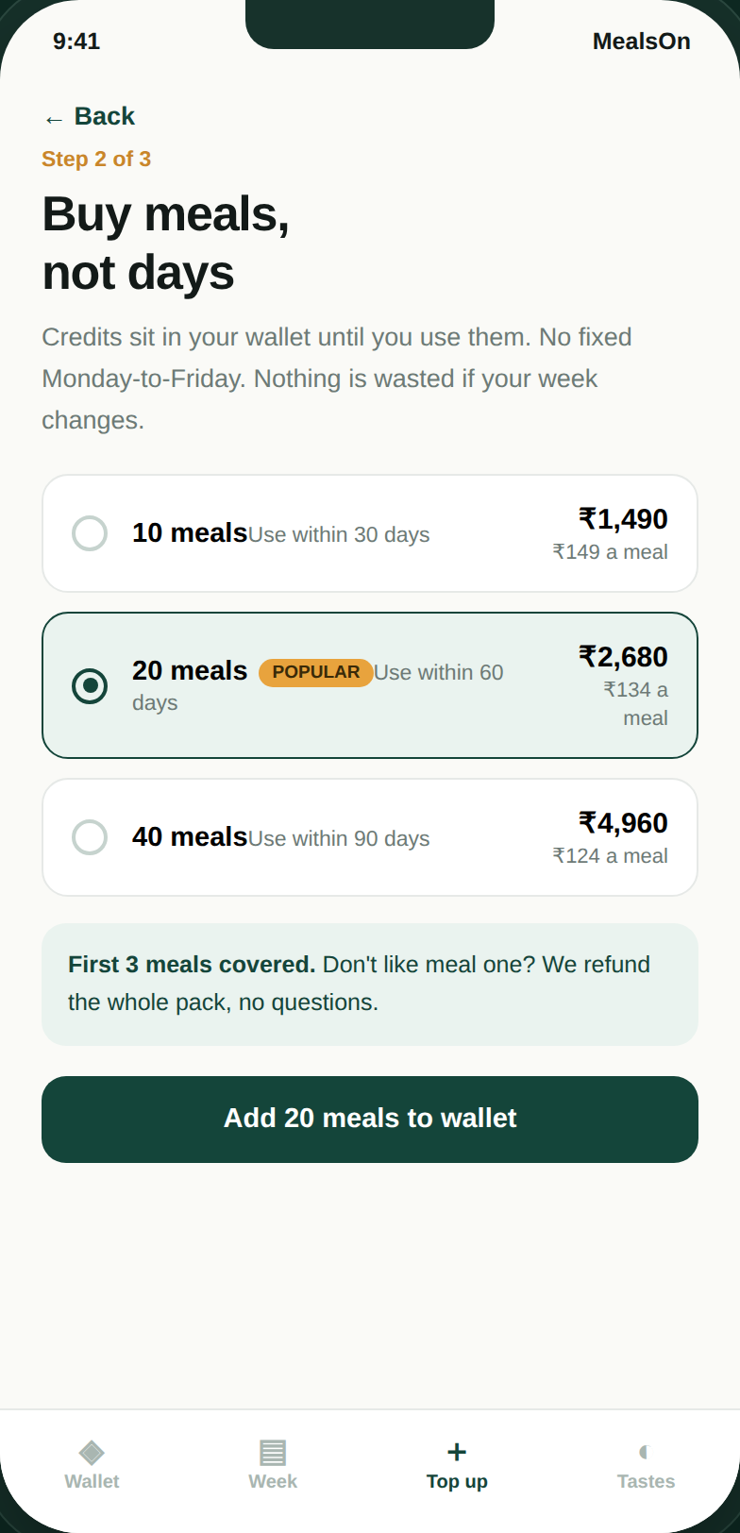
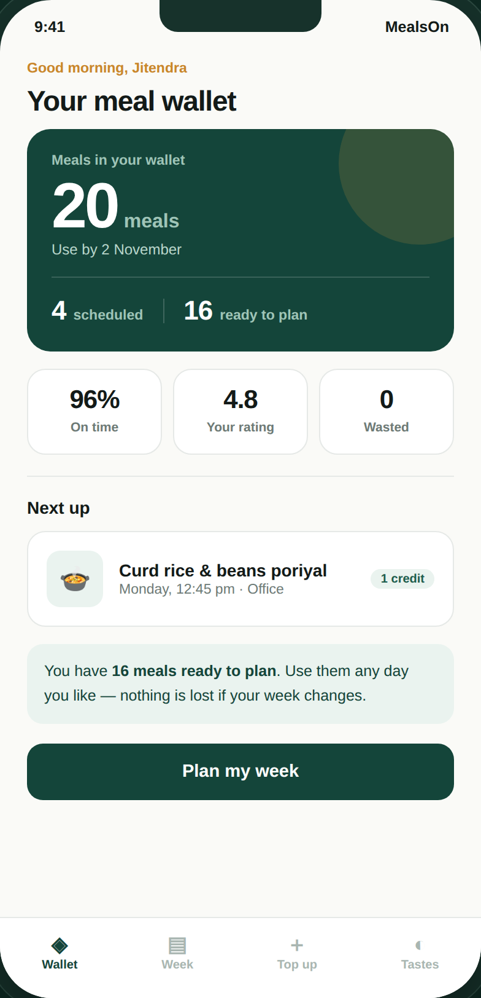
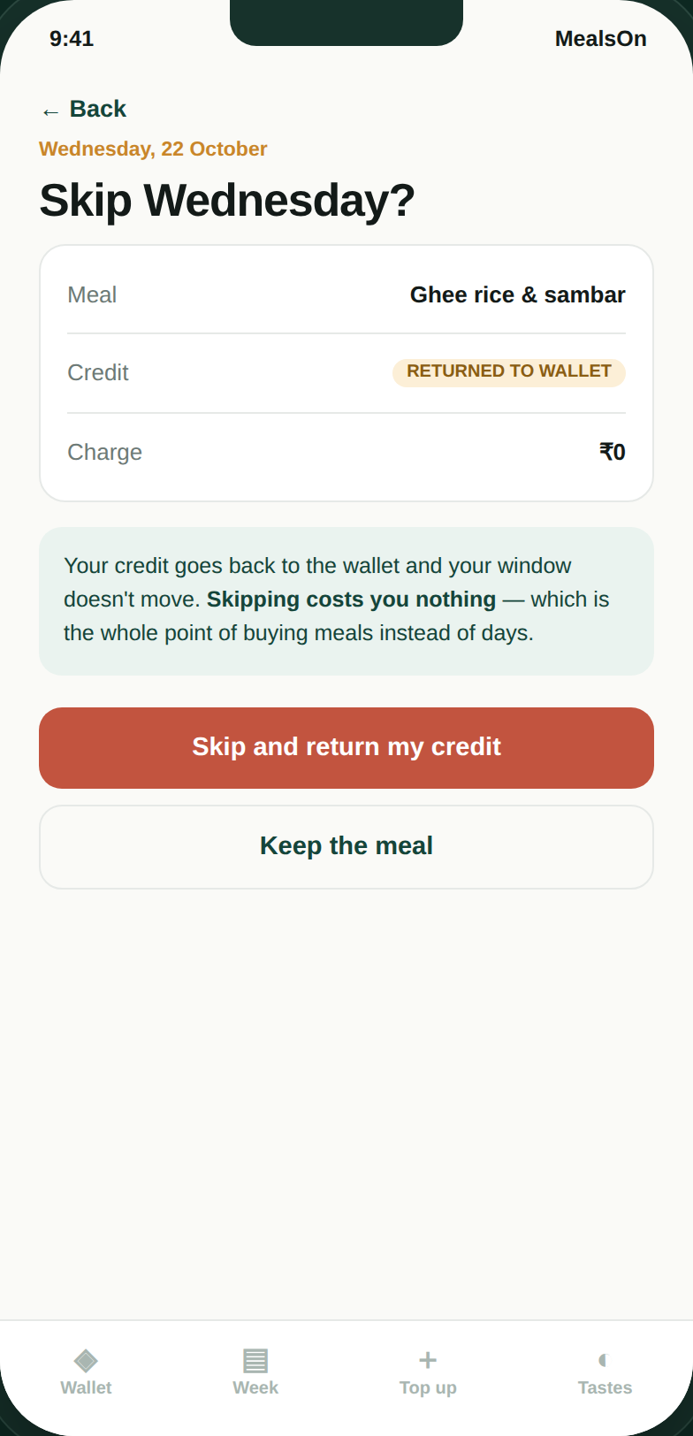
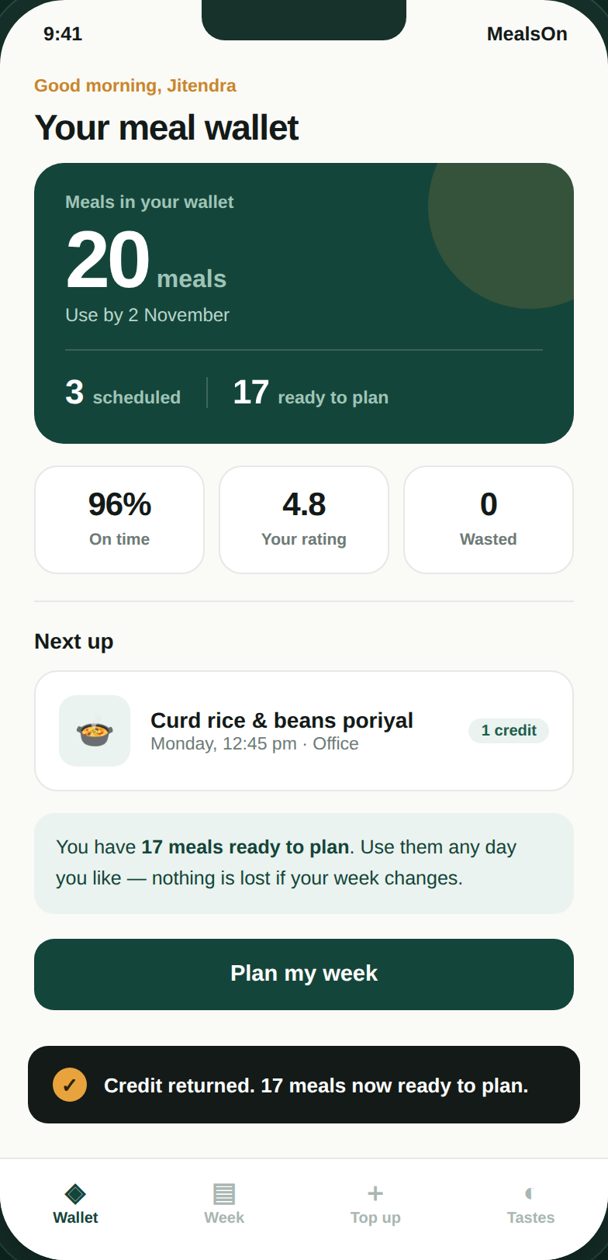
BUILT, NOT JUST DESCRIBED
I prototyped it — here is the moment that matters
The whole argument, in one screen
Skip a day and the credit returns to the wallet. Scheduled drops, ready-to-plan rises, the balance is untouched, and the charge is zero.
On every competitor, that day’s money is simply gone.
Buy meals, not days
The meal wallet
Skip Wednesday
Credit comes back
Clickable prototype — six connected screens with real state. Working file submitted alongside this deck.
Notes:
Do not just show this slide — switch to the live prototype and click through it. Skip Wednesday on camera.

Slide 17
HOW I WORKED ON THIS
AI did the legwork. The judgement is mine.
Research
Used AI to pull the category history — Swiggy Daily’s 2019 launch, its shelving, the 2024 relaunch, Zomato Everyday. Then verified the claims before putting them on a slide.
Pressure-testing
Argued the prioritisation against AI as a sparring partner: what breaks if flexibility is unlimited, where does the credits model hurt operations. That is where the forecast trade-off surfaced.
Prototyping
Built the clickable prototype with AI assistance, then QA’d it in a headless browser — six flows, state assertions, screenshots. Found and fixed five defects, three of which only showed up on visual inspection.
What I did not delegate
The reframe, the prioritisation calls, the trade-offs I chose to accept, and what I left out. AI compresses the work; it does not make the decisions.
Five defects found in QA: an animation on a number that never changed, hardcoded copy in three places, and a pack size that could produce an impossible state.
Notes:
This slide exists because AI Fluency is their first assessment dimension. Being specific about what I did NOT delegate is the credible part.

Slide 18
IF I ONLY GET ONE THING RIGHT
Stop selling a calendar.
Start selling meals.
Every competitor still asks the user to commit to specific days and then fight the product when life changes. Decoupling the purchase from the calendar fixes the activation barrier and the churn driver at the same time — and it is the one change none of them have made.
Thank you · Jitendra Singh
Notes:
Close on one memorable line. If they remember nothing else from the video, they remember "stop selling a calendar, start selling meals."

